Slide 1
Setting Up Multi-Car Experiments with TORCS
Resilient Distributed Systems 2019

Slide 2
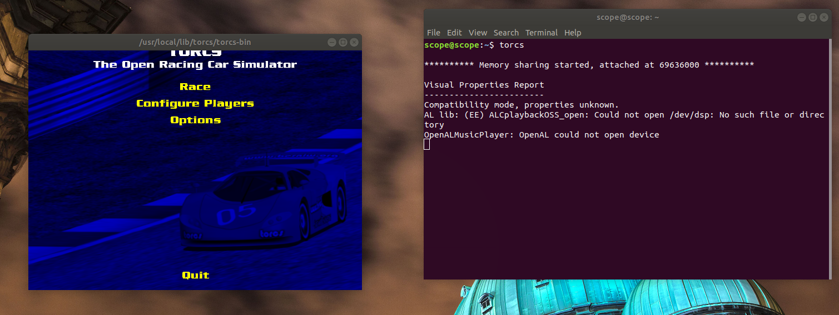
Start TORCS
After installing TORCS https://github.com/fmirus/torcs-1.3.7#torcs-137
Open a terminal (ctrl + alt + t) and type torcs.

Slide 3
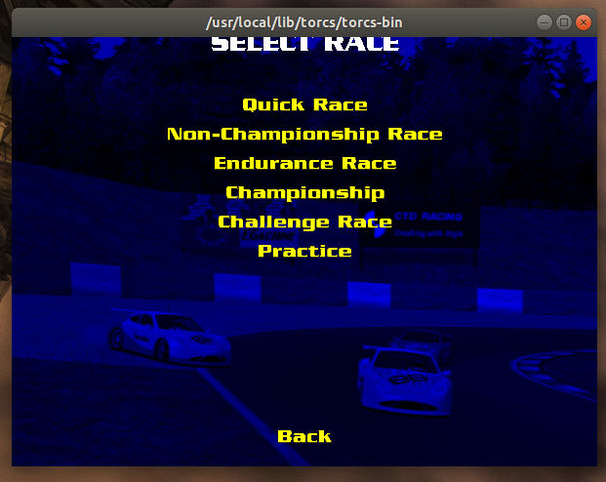
Configure Race
TORCS simulator opens up. Now select Race.
Always keep the terminal open.
Now select Configure Race.

Slide 4
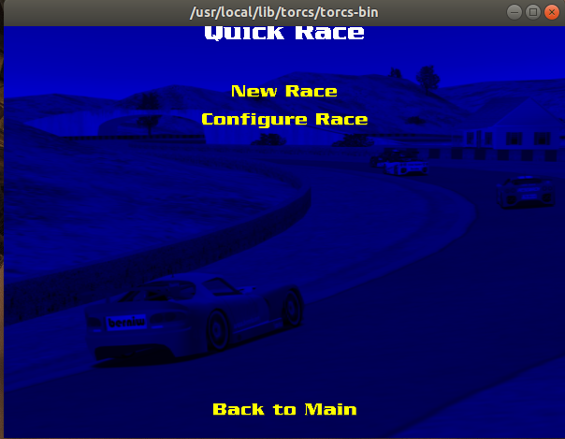
Configure Race
To set up multi-car experiment select Configure Race. (only first time)
Next time onwards select New Race to start a new race.
You only have to configure the Race once. You do not have to do it every single time.
Configure only once in the beginning

Slide 5
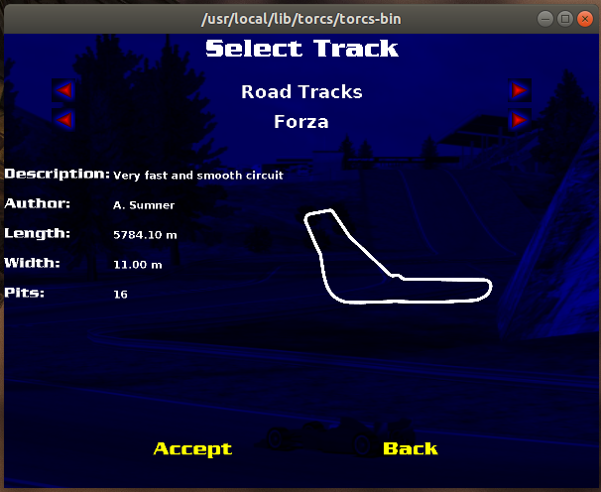
Select Track
Select Forza track for the experiments.
The PID controllers are tuned to work on this track.
Select the Accept option.

Slide 6
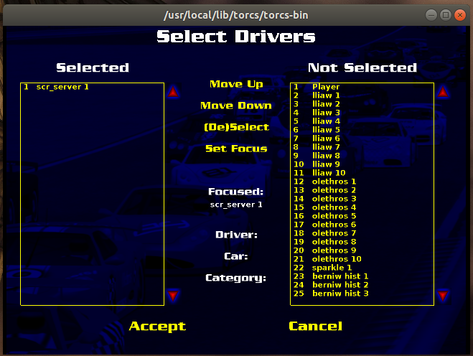
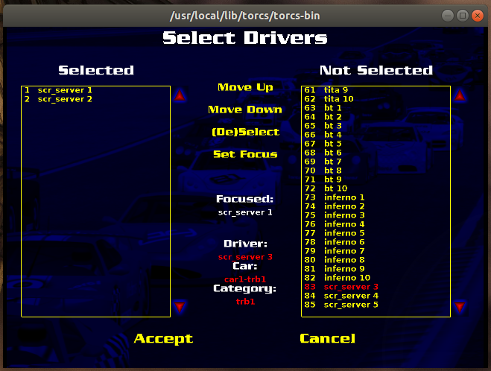
Select Multiple Cars
Initially you will only have one car in the simulation.
To add second car scroll down to select scr_server2.
Then press (DE)Delect.
You will get scr_server 2 listed under selected driver. Then select Accept.

Slide 7
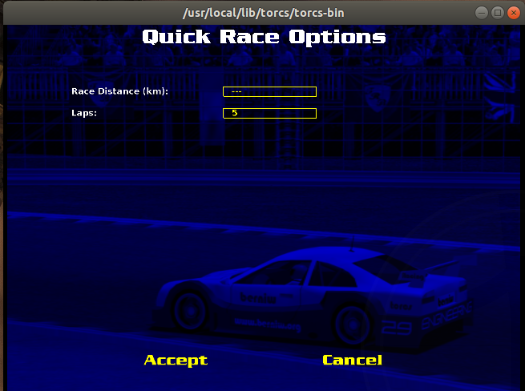
Select Laps
Now select the number of laps you want to race.
Then press Accept.

Slide 8
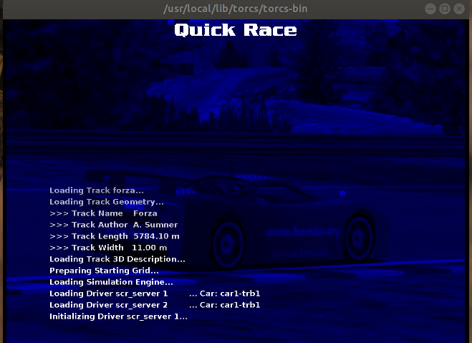
Race
You have finished the configuration. You can start the Race.
Select New Race.
You are now ready to use the simulator.

Slide 9
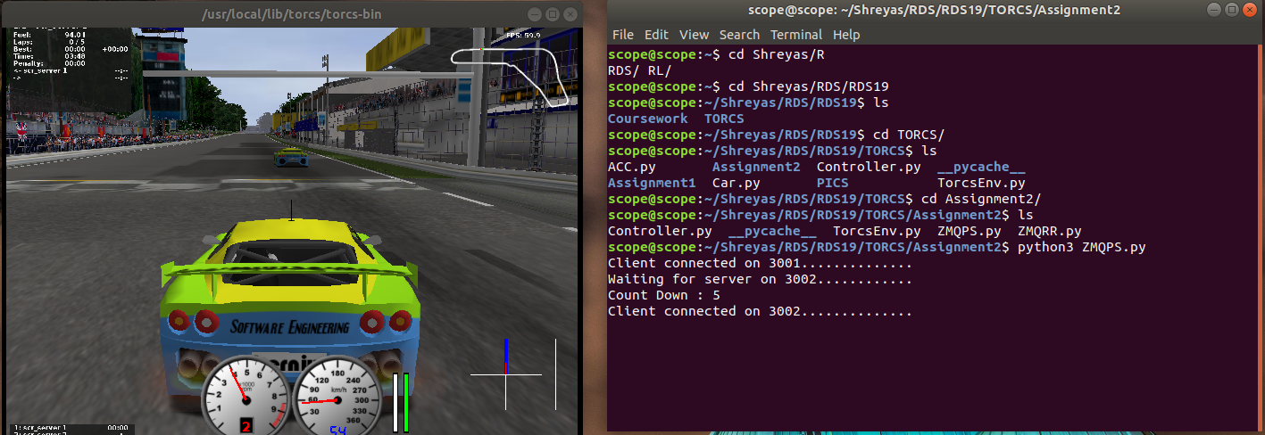
Start Racing
To start racing open a new terminal and run your the Car.py script.
This should get the simulator to work.
To stop the simulation, select the simulation terminal and press esc.

